Slide 1
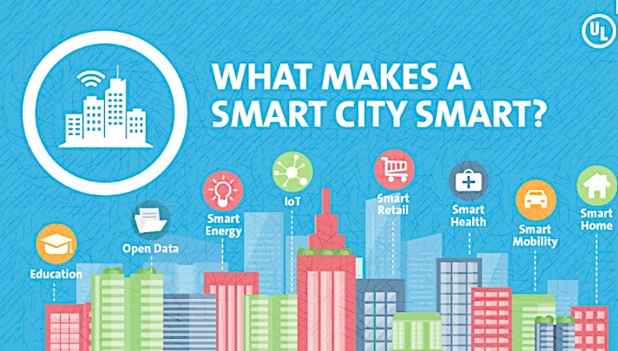
SMART CITY M.DRUMARE

Slide 2
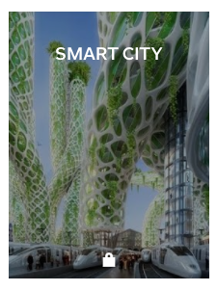
ON FLIPBOARD
http://flip.it/D5YJSd

Slide 3
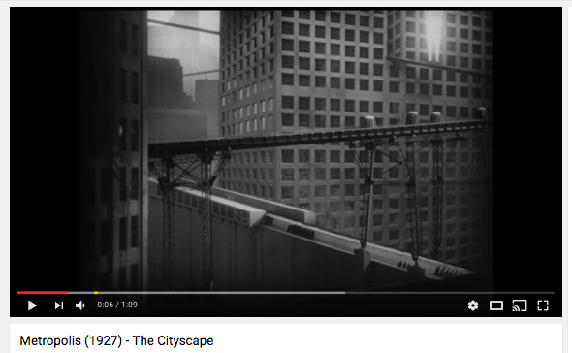
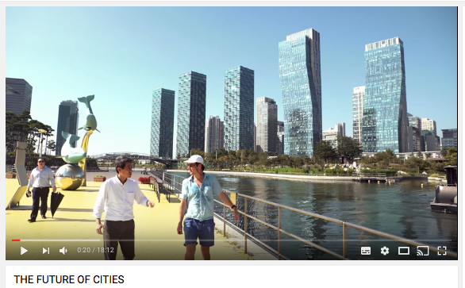

Slide 4
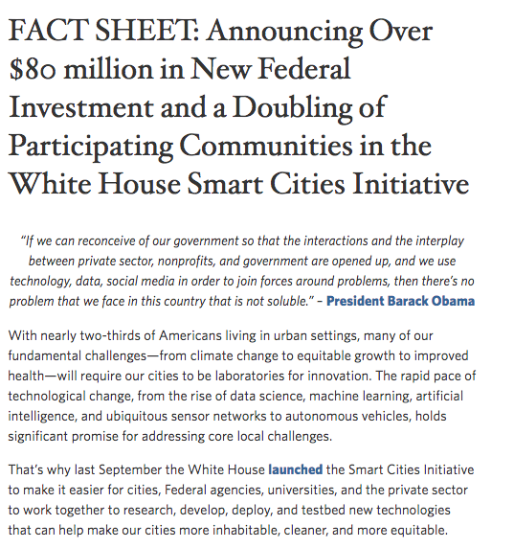
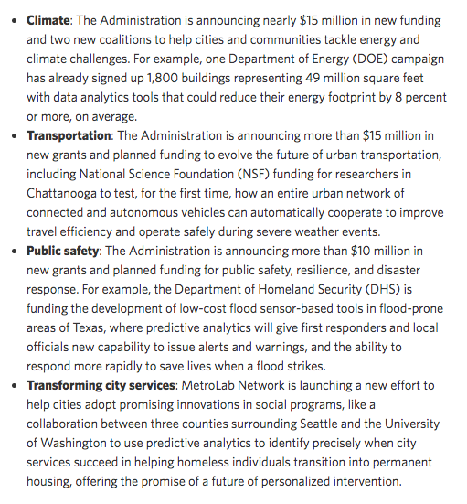
AMERICAN INVESTMENT-SEPT 2016

Slide 5
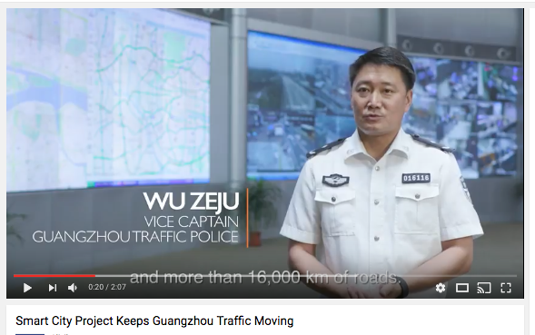
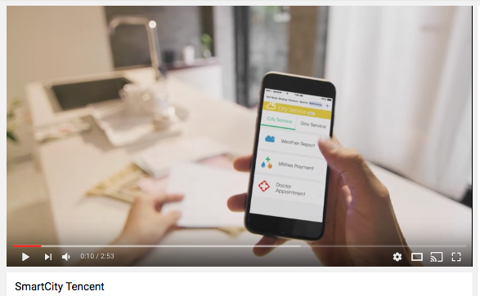
CHINESE COMPANIES INVESTMENT-DEC 2016
Alibaba Group Holding's Fintech arm, announced on Tuesday that it has teamed up with 352 cities in 25 provinces to facilitate government-backed smart city projects, which its rivals - Baidu Inc and Tencent Holdings - also have their eyes on.
Guangzhou is one of the busiest cities in China. To solve its traffic problems, the Guangzhou Traffic Police turned to the “Smart City” initiative powered by Ali Cloud. See how the data provided by Alibaba’s AutoNavi has helped Guangzhou improve traffic conditions.

Slide 6
WHAT ?

Slide 7
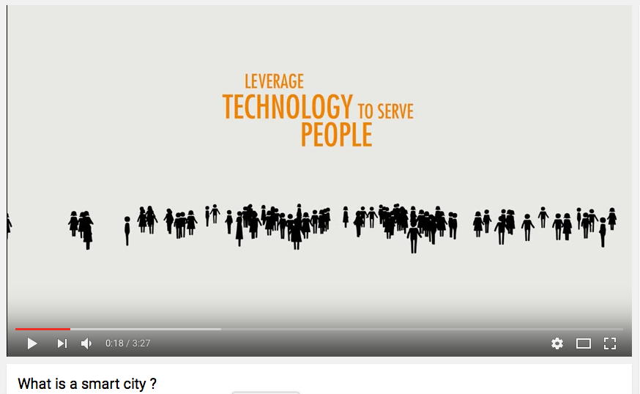
SMART CITY
A smart city is an urban development vision to integrate multiple information and communication technology (ICT) and Internet of Things (IoT) solutions to manage a city's assets.
The city's assets include schools, libraries, transportation systems, hospitals, power plants, water supply networks, waste management, law enforcement, and other community services.
A city is "smart" when "investments in human and social capital and traditional (transportation) and modern (ICT) infrastructure fuel sustainable economic growth and a high quality of life, with a wise management of natural resources, through participatory government" (Caragliu, 2009).

Slide 8
SYNOMYMS OF SMART
CONNECTED
INTELLIGENT
DIGITAL
GREEN
SUSTAINABLE
RESILIENT
QUANTIFIED
PARTICIPATIVE
SHARING

Slide 9
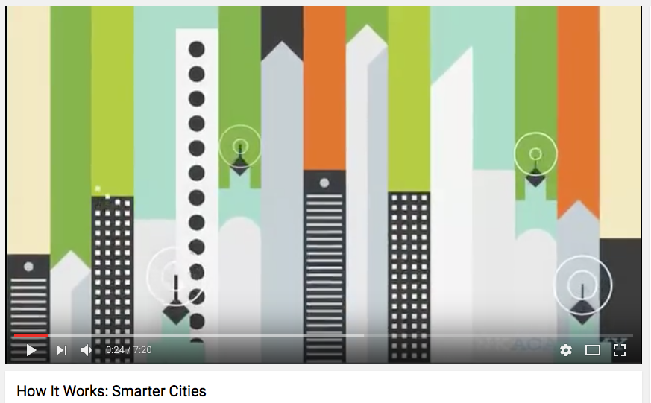
3 LEVELS OF INTELLIGENCE
From the countries which implemented smart cities from the entire world have identified three distinct levels (Spiro, 2006), (Schaffers, 2012)
Network: The first step for the smart city is based on the physical telecommunications network infrastructure, comprised of the wiring, the wireless, together with any servers and routers required for operating the infrastructure.
Applications : The second step constitutes applications that facilitate operations in the city, like traffic control, etc.
Connectivity: The third step is based by ubiquitous or connectivity of all.

Slide 10
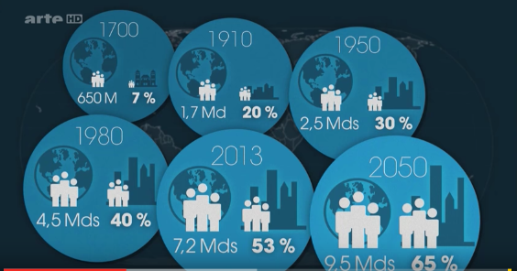
X FACTORS
Population Growth.
Urbanization.
Global Warming.
Mobile and wireless technologies.
Digitalization.
New Urban Mobility.
The World Health Organization reports that for the first time ever, the majority of the world's population lives in a city, and this proportion continues to grow with projections of 70 percent by 2050.

Slide 11
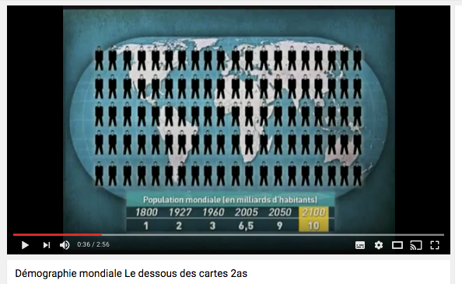
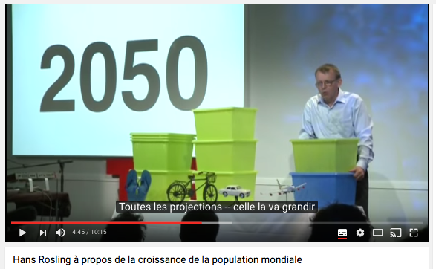
POPULATION GROWTH

Slide 12

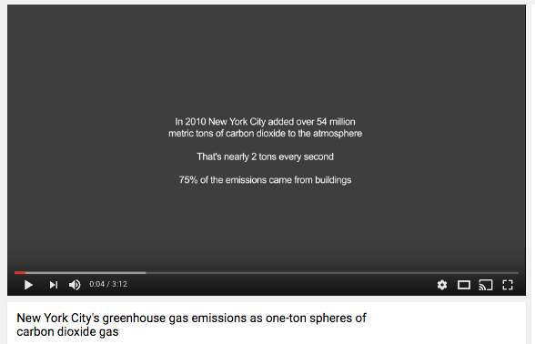
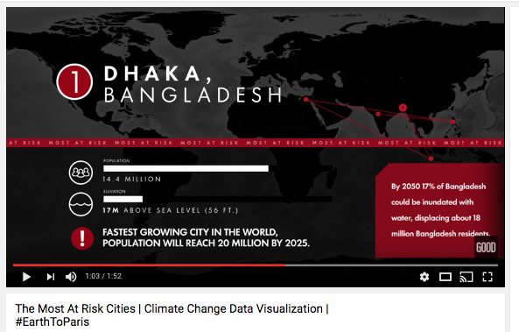
THREAT OF GLOBAL WARMING

Slide 13
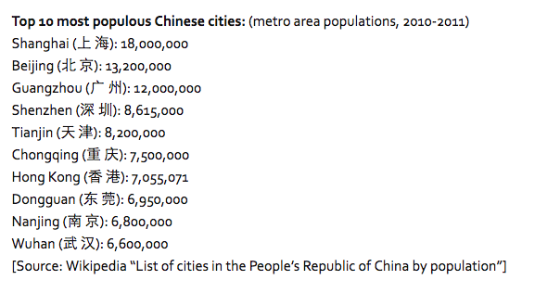
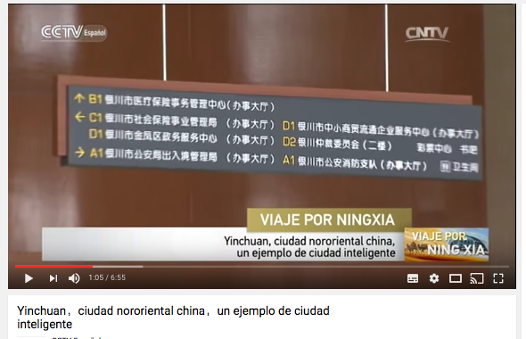
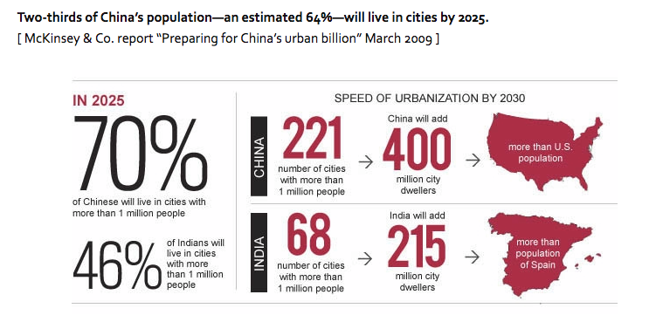
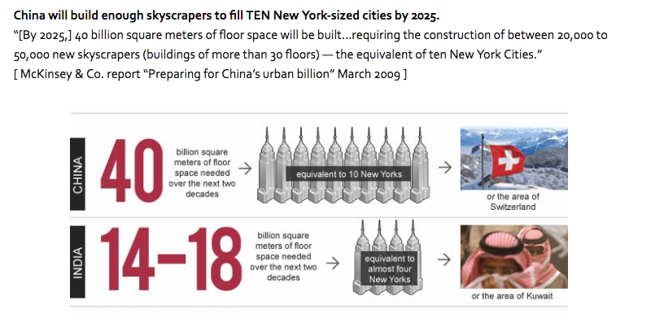
URBANIZATION: CHINA MEGA-CITIES

Slide 14
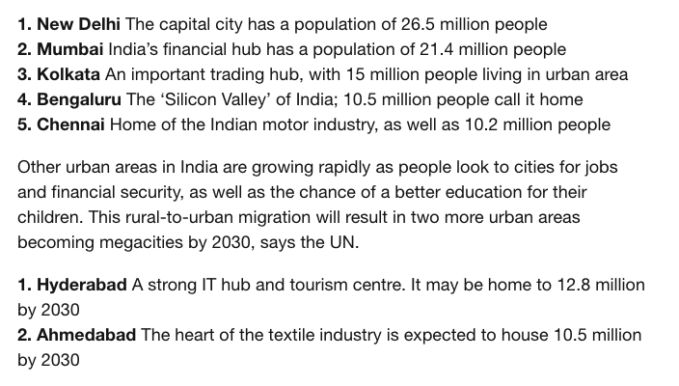
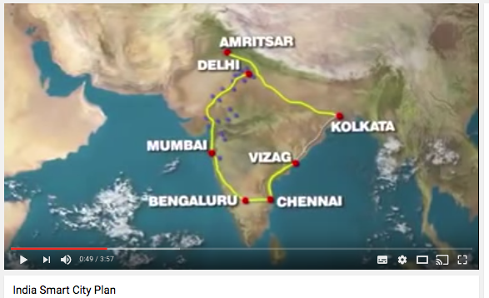
URBANIZATION : INDIA MEGA-CITIES

Slide 15
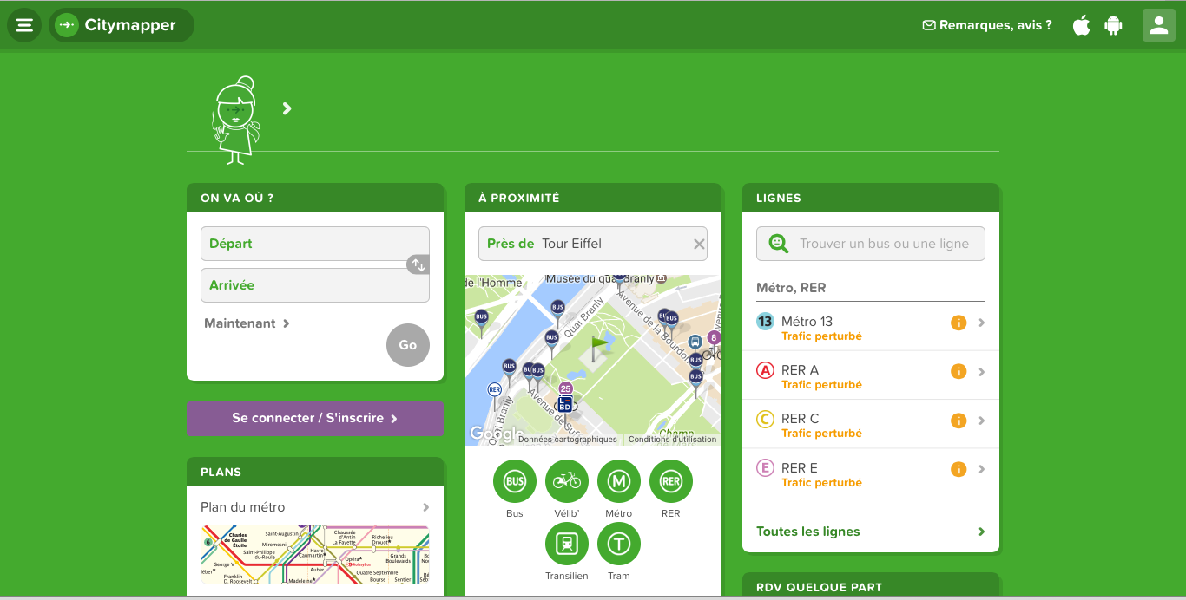
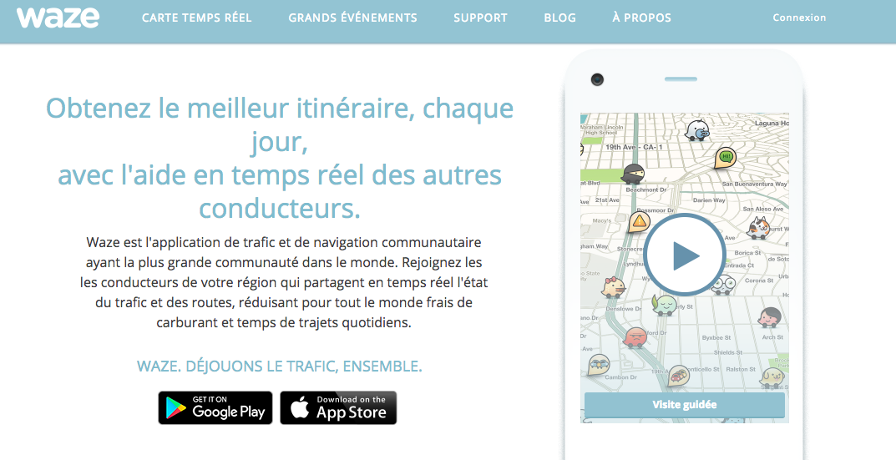
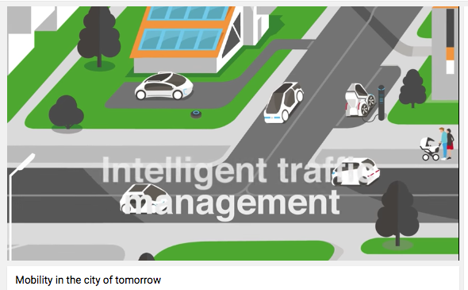
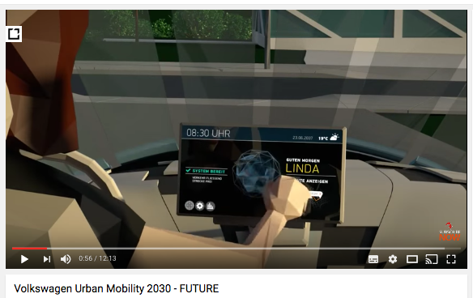
NEW URBAN MOBILITY

Slide 16
SMART CITY AS A SYSTEM OF SMART SYSTEMS
Smart Energy.
Smart Transports (Mobility)
Smart Water Management.
Smart Waste Management.
Smart Buildings.
Smart Safety and Security.
Smart Health.
Smart Education.
Smart Citizens.

Slide 17
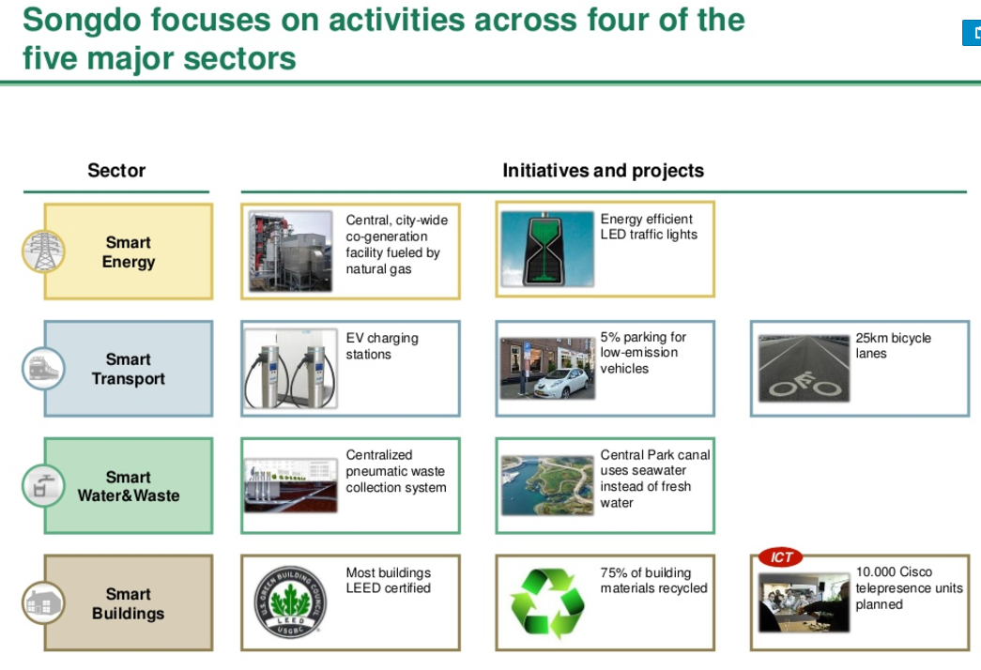
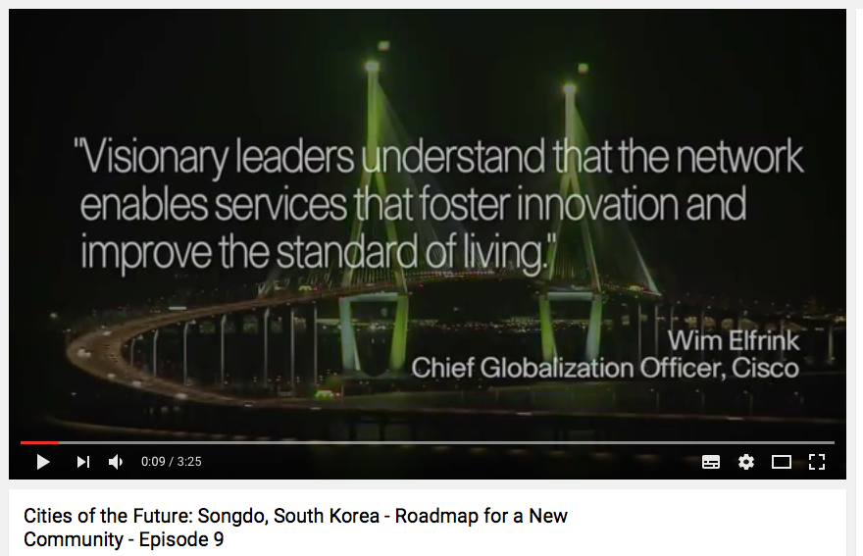
SMART SECTORS

Slide 18
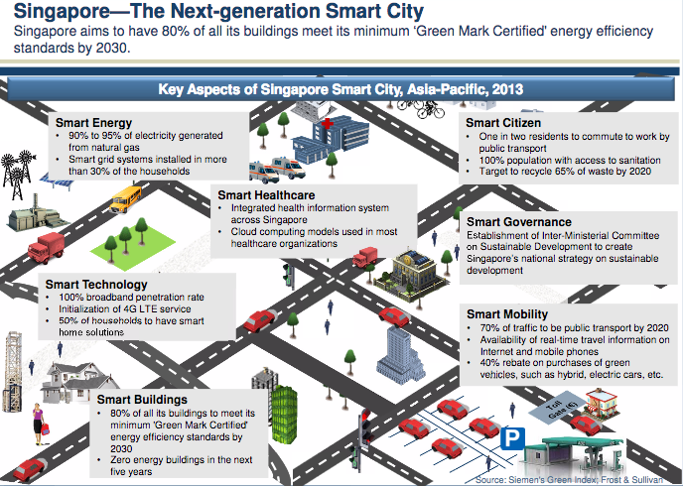
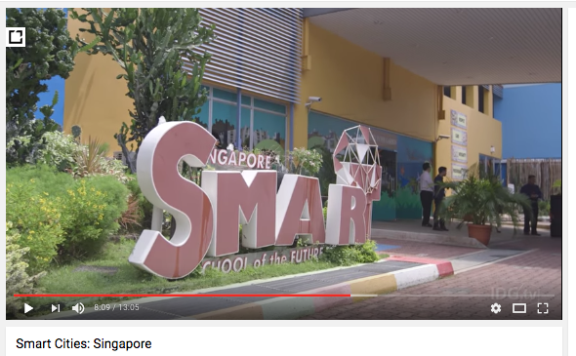
SMART ECO-SYSTEM : SINGAPORE

Slide 19
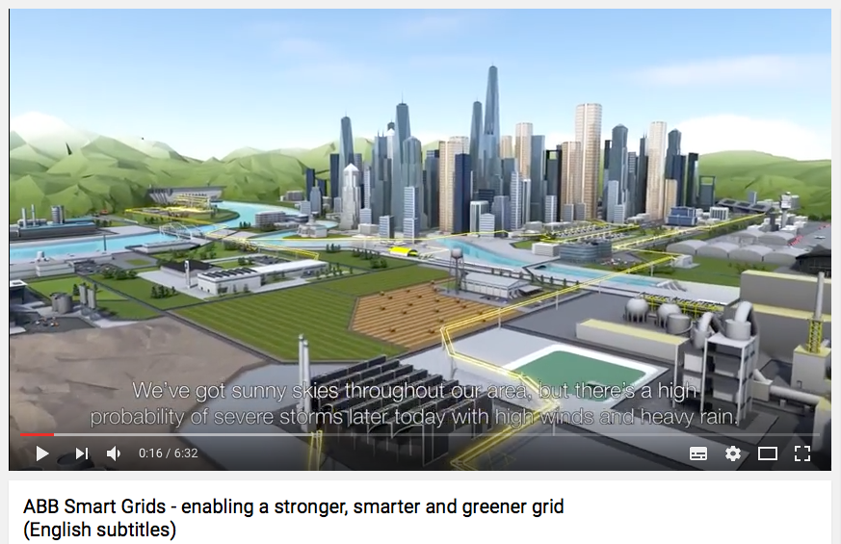
SMART ENERGY (SMART GRIDS)
Modernization of power systems through self-healing designs, automation, remote monitoring and control, and establishment of microgrids.
Information and education of the consumers about their energy usage, costs and alternative options, to enable them to make decisions autonomously about how and when to use electricity and fuels.
Increasing safety, security and reliable integration of distributed and renewable energy resources.

Slide 20
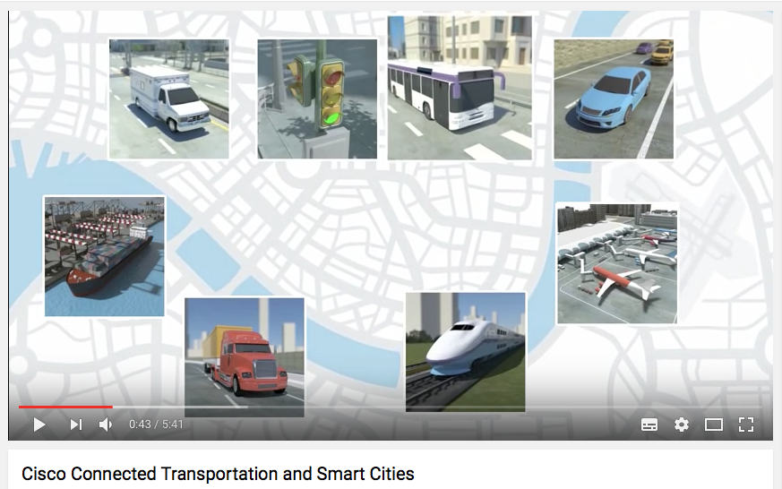
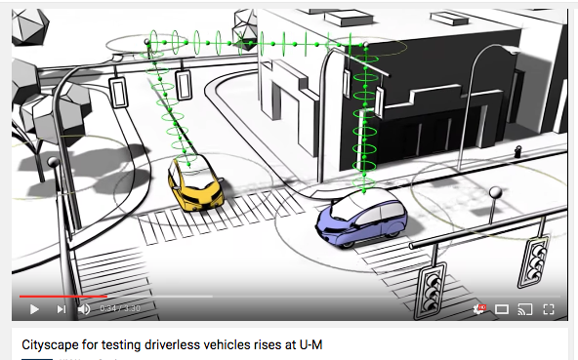
SMART TRANSPORTS
Wordings : New-mobility grid, New-mobility ecosystem, Urban-mobility.
Goals : Reduction of traffic congestion and pollution, improvement in the mobility of people and freight, more safety and security.
Wide Perimeter: From transportation on demand to self-driving car.
Numerous Actors: Tech Industry, Automotive Industry, Universities, Governments.

Slide 21
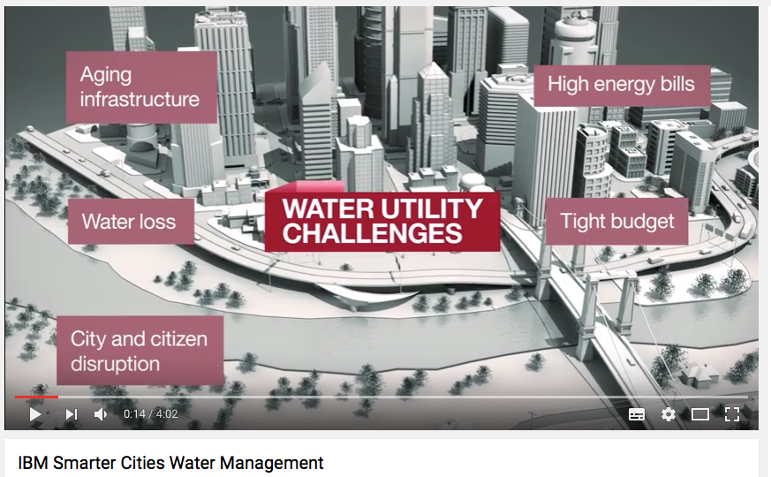
SMART WATER MANAGEMENT
The term "smart water" points to water and wastewater infrastructure that ensures this precious resource - and the energy used to transport it - is managed effectively.
A smart water system is designed to gather meaningful and actionable data about the flow, pressure and distribution of a city's water.
Further, it is critical that that the consumption and forecasting of water use is accurate.

Slide 22
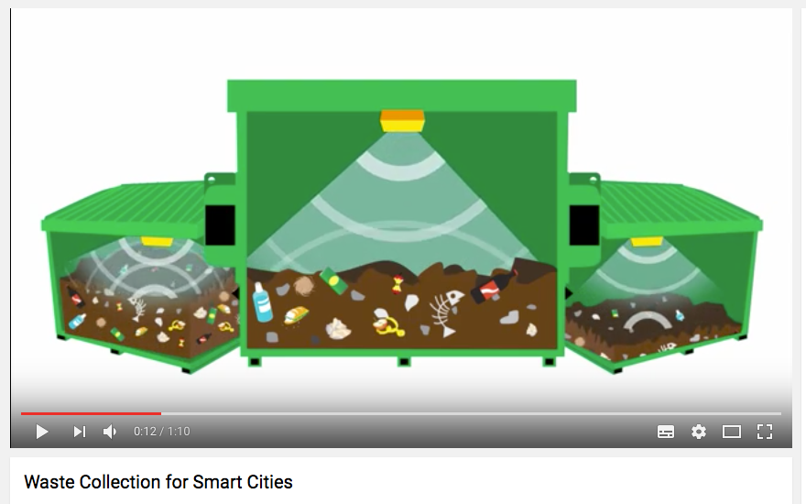
SMART WASTE MANAGEMENT
Sensors and software system that, when placed on the lids of garbage receptacles, can “talk” to the waste management company.
Smart Informations : when the container is at full capacity, when it needs to be emptied, what is the temperature of the container
Allowing the sanitation specialists to work more efficiently and cut unnecessary costs.
Additionally, the sensors can help the company forecast when a dumpster will be full, allowing them to plan ahead future routes.

Slide 23
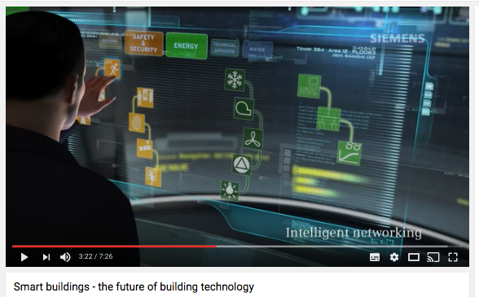

SMART BUILDINGS
Deliver useful services (e.g. illumination, thermal comfort, air quality, physical security, sanitation, and many more) at the lowest cost and environmental impact over the building lifecycle.
Use information technology during operation to connect a variety of subsystems.These systems can share information to optimize total building performance.

Slide 24
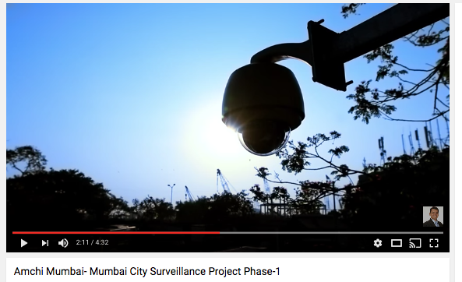
SMART SAFETY
Protect cities against crime, terrorism, and civil unrest.
Help law enforcement monitor public areas, analyze patterns, and track incidents and suspects, enabling quicker response.
Combine information from video surveillance cameras, social media, citizen reports, and other sensors, the solution provides a richer view of urban safety.

Slide 25
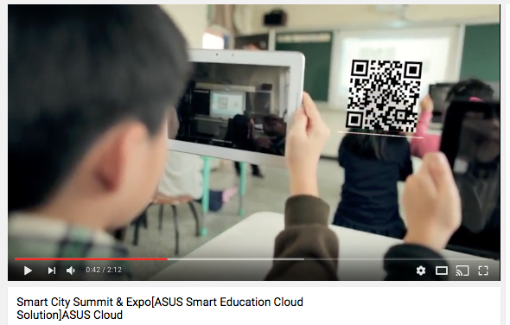
SMART GOVERNANCE & EDUCATION
In Taiwan, a cloud platform is endorsed by the central government, local governments, and universities provides citywide service to tens of thousands of users, featuring an open API architecture to enable interaction between applications and data and speed up education ecosystem development.

Slide 26


SMART HEALTH
Enabling social care at home.
24/7 health 'safety nets' for the vulnerable.
Video call doctors and vital sign wearables.
Smart Hospital and Health centers.
Startups helping healthtech grow.

Slide 27
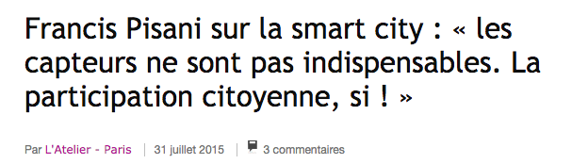
SMART CITIZEN FIRST
The concept of a Smart City, as advertised by tech giants like IBM, Cisco and Siemens, is a city with sensors in every aspect of everyday life, gathering large amounts of data and using algorithms to optimize everything in the city.
The problem of the Smart Cities, in the way proposed by many of these companies, is that they are merely a means to monetize the “Internet-of-Things ». It will shift the power from the citizens to a top-down city control centre.

Slide 28
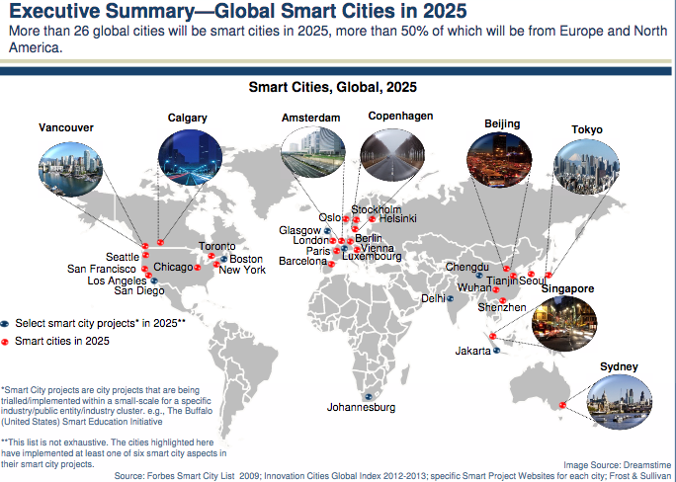
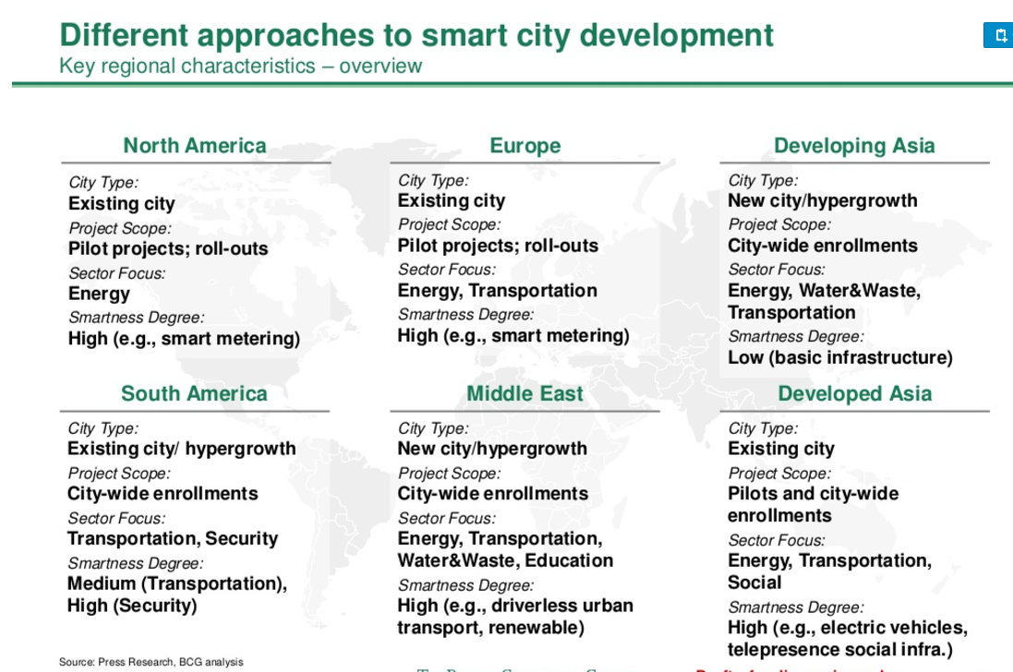
SMART CITY IS NOT A UNIQUE MODEL

Slide 29
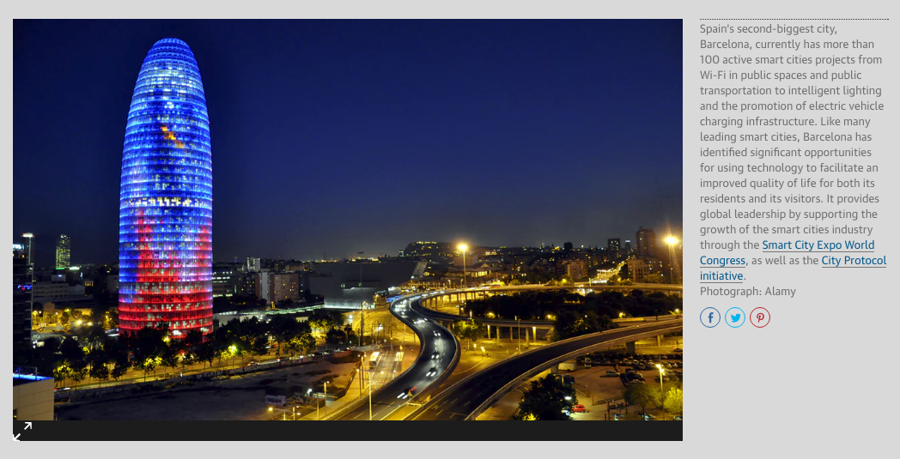
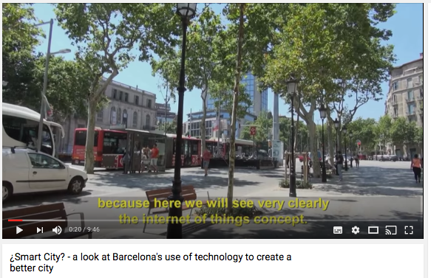
BARCELONA : PIONEER EUROPEAN CITY

Slide 30
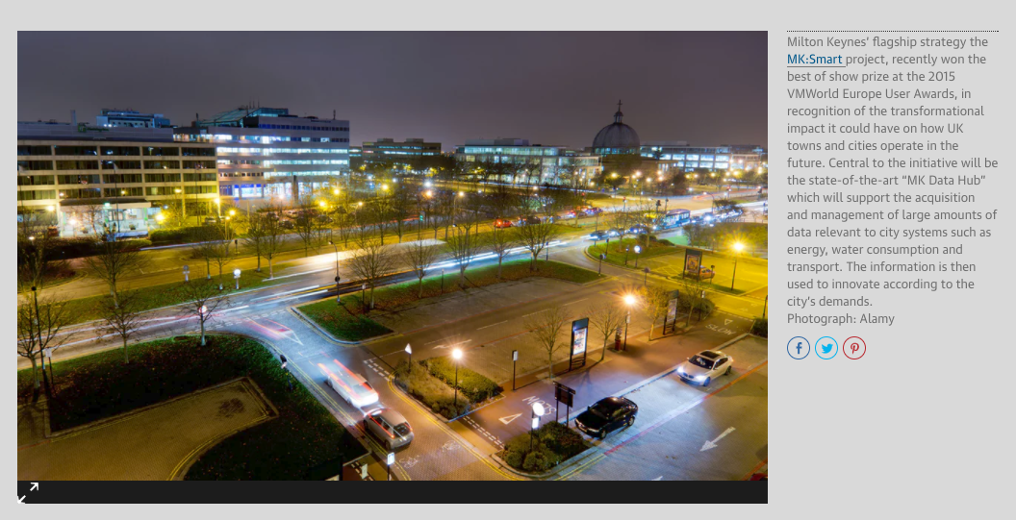
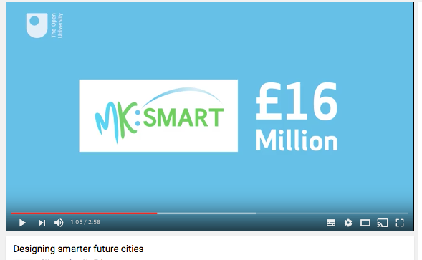
MILTON KEYNES : DATA-DRIVEN CITY

Slide 31
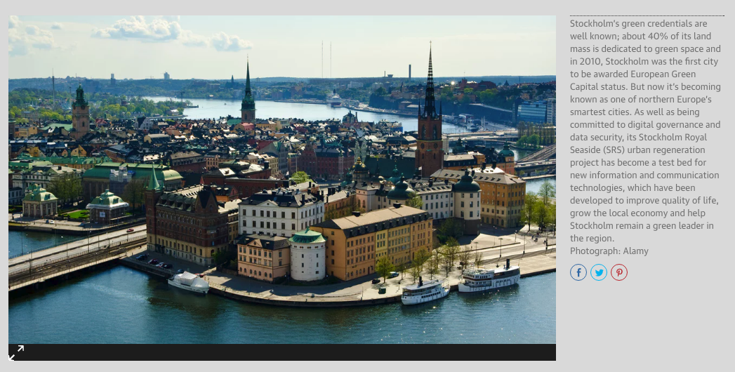
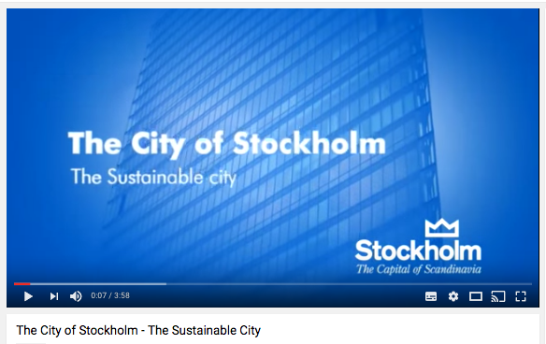
STOCKHOLM : GREEN CITY

Slide 32
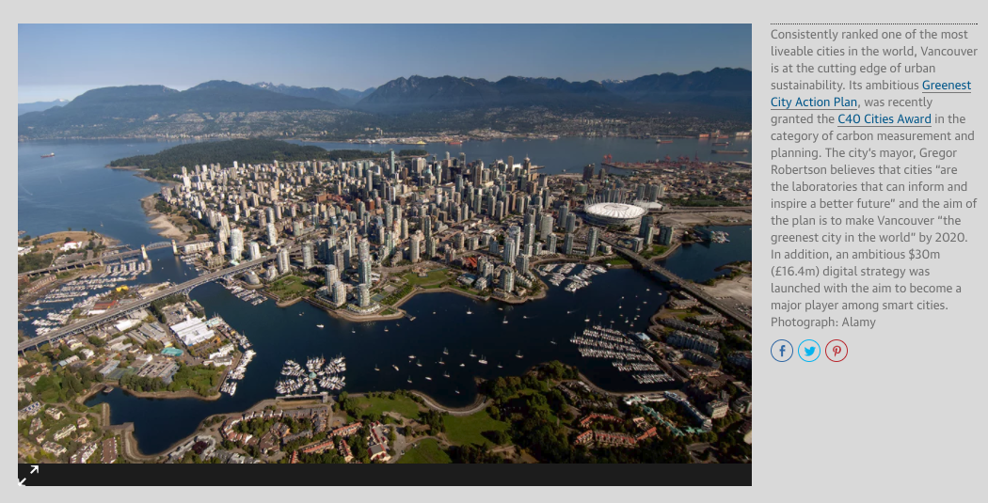
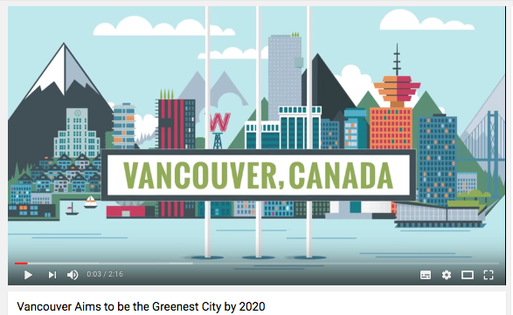
VANCOUVER: GREENEST CITY

Slide 33
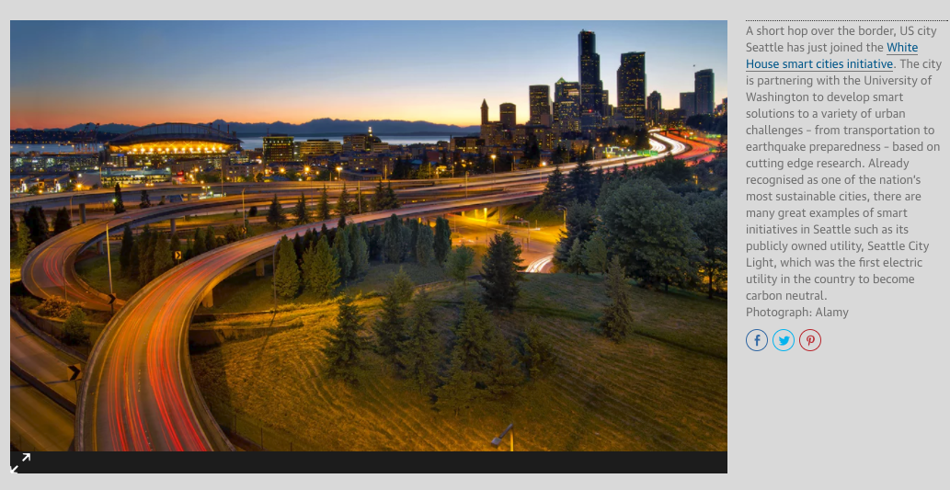
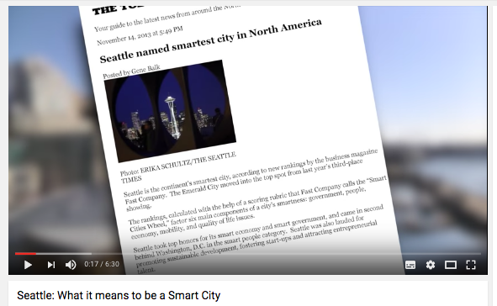
SEATTLE : HACKHATON CITY

Slide 34


MEDELLIN : MIRACULOUS CITY

Slide 35



SEOUL : PIONEER ASIAN CITY

Slide 36


NANJING : MOBILITY CITY

Slide 37


CHENNAI: INDIAN MODEL

Slide 38


JOHANNESBURG : DIGITAL AMBASSADORS

Slide 39


SMART DIVERSITY
Source : Paolo Neirotti, Alberto De Marco, Anna Corinna Cagliano, Giulio Mangano and Francesco Scorrano; Researchers in the Department of Management and Production Engineering at Politecnico di Torino. 2014

Slide 40


Slide 41

SMART CITY EVOLUTION: DATAPOLIS & PARTICIPOLIS

Slide 42


SMART CITY IS A BUSINESS
According to IHS, by2025, Asia Pacific will account for 32 smart cities, Europe will have 31, and the Americas will home to 25 smart Cities.
Navigant Research forecasts global smart city technology revenue will grow from $8.8 billion annually in 2014 to $27.5 billion in 2023, while Frost & Sullivan expects the global smart city market will be valued at $1.565 trillion in 2020.
By 2025 demand for smart city services will grow in Latin America by 46%, Middle East and Africa by 39%, and Central and EasternEurope by 31%

Slide 43
RETHINKING SMART CITIES FROM THE GROUND UP
Set up a civic innovation lab to drive innovation in collaborative technologies.
Use open data and open platforms to mobilise collective knowledge.
Take human behaviour as seriously as technology.
Invest in smart people, not just smart technology.
Spread the potential of collaborative technologies to all parts of society.

Slide 44
HOW ?

Slide 45


DEVELOP INFRASTRUCTURE (WIFI)
Smart cities connect everything – buildings, lights, meters, and streets – to the Internet through the power of Wi-Fi.
Cities like New York City and London are making their move into the future by implementing public-private partnerships to extend the range, accessibility, and speed of Wi-Fi for their millions of residents.
For example, New York’s LinkNYC initiative will replace old phone booths with 500 free gigabyte Wi-Fi kiosks

Slide 46


DEVELOP INFRASTRUCTURE (5G)

Slide 47


INTERNET OF THINGS (HAMBURG)
Smart cities use Internet of Things (IoT) devices such as connected sensors, lights, and meters to collect and analyze data.
The cities then use this data to improve infrastructure, public utilities and services, and more.

Slide 48

IOT SMART LIGHTNING (LOS ANGELES)

Slide 49




DATA INTEGRATION (SANTANDER)

Slide 50




DATA VISUALIZATION (SINGAPORE)

Slide 51

DATA VISUALIZATION (NEW YORK CITY )
January 2017, the N.Y.C. Mayor’s Office officially launched its own dashboard meant to do just that, built by Vizzuality and Carto, a platform for location data tools.
It’s designed to make sense of the bottomless data silos that a city as big, complex, and connected as New York generates every hour.
The dashboard pulls data from across the city, mapping it geographically to give decision-makers a bird’s-eye view of hundreds of "indicators" from across city organizations, which vary wildly across agency and can involve anything from robberies to traffic fatalities.

Slide 52

PREDICTIVE ANALYTICS (MEMPHIS)
Memphis Police Department reduced crime by 30% using data to focus patrols.
By integrating data and performing analysis and statistical modeling, the Memphis Police Department can predict crime hot spots and direct police resources more intelligently.
Such smart policing practices have reduced overall crime by 30% and violent crime by 15%.

Slide 53

PREDICTIVE ANALYTICS (RIO DE JANEIRO)
Rio de Janeiro improved emergency response time by 30% with centralized command center City officials in Rio.
Home to over 6 million people, have integrated information and processes for more than 30 agencies into one command center enabling them to respond quickly to current events and better predict and plan for future events.

Slide 54

PREDICTIVE ANALYTICS (ZHENJIANG)
Zhenjiang, China builds more intelligent transportation system positioning city for future growth
A central transportation command center will help analyze traffic patterns, obtain and disseminate real-time traffic updates, and anticipate and minimize traffic issues for this city of three million people.

Slide 55


OPEN DATA-API (AMSTERDAM)

Slide 56



OPEN DATA-SETS OF DATA (RATP-PARIS)

Slide 57



OPENDATASOFT PORTAL (PARIS-BRUXELLES )

Slide 58


OPEN SOURCE PLATFORM SMARTCITIZEN KIT
Smart Citizen is the world’s largest independent environmental sensing network, and the platform is now live in Manchester.
Manchester is only the third city in the world to create its own Smart Citizen community, after successful launches in Barcelona and Amsterdam.
This experimental network enables citizens to become active in capturing, sharing and making sense of the data that lies within their city, through the use of low-cost sensors – the Smart Citizen Kit (SCK)

Slide 59


SMART CITY HACKATHON (SAN DIEGO)
The SmartCity Hackathon attracted more than 200 software developers and technology designers.
They tapped into 500 data sets from the city and others on energy use, water consumption, traffic, parking, weather patterns, infrastructure and mass transit.

Slide 60


SMART CITY CHALLENGE (USA)

Slide 61

GAMIFICATION (MAPATON CDMX MEXICO)
Most of bus routes in Mexico City have been developed organically in response to demand, which means that routes are communicated largely informally through friends and family.
In an attempt to formalize the system, Mapatón CDMX designed a participatory game that drew on crowdsourced information from cell phones to come up with a map of the city’s bus routes.
The group behind the project included 34 people from 14 different organizations, including nonprofits, think tanks, engineering firms, members of government bodies, and consultancies.

Slide 62

CROWDSOURCING & CIVIC HACKING (Fix My Street)
A Civil Hacker is one who collaborates with others to create open source solution using publicly-released data, code and technology to solve local social, economic, and environmental challenges.
Crowdsourcing is a specific sourcing model in which individuals or organizations use contributions from Internet users to obtain needed services or ideas.

Slide 63

SOCIAL NETWORKS (JAKARTA-TWEETER)
Jakarta, a city notorious for its seasonal flooding, found a way to formalize citizen information networks and respond to its frequent natural disasters with PetaJakarta (Map Jakarta).
Capitalizing on citizens’ usage of Twitter to inform one another of areas to avoid during times of flooding, PetaJakarta utilizes the social media network as an emergency data gathering and critical alert service in order to “…gather, sort and display information about flooding for Jakarta residents in real time.”
Citizens are also able to ask questions that they have about flooding in specific neighborhoods.

Slide 64


APPS & DATA SHARING (UBER, WAZE, STRAVA)
Uber Movement uses information on the billions of rides Uber has completed. It’s free, open to anybody, lets users track car travel times between any two points in a city at any time of day.
Through its “Connected Citizens” program, Waze works with cities all over the world, trading user driving info for real-time and advance notice of construction and road closures to put on its maps.
Cycling app Strava peddles data to cities eager to know where their residents are riding.

Slide 65
IMPACTS ?

Slide 66


SOCIAL APARTHEID?
The Indian economist and consultant Laveesh Bhandari described smart cities as “special enclaves” that would use prohibitive prices and harsh policing to prevent “millions of poor Indians” from “enjoying the privileges of such great infrastructure”.
For the french sociologue Olivier Mongin, the smart city can increase the gap between the hyper-connected areas and non or less connected areas.

Slide 67


EQUAL OPPORTUNITY ?
Most Smart cities programs have failed to develop policies that ensure their programs and services are accessible to persons with disabilities and the aging.
As cities evolve and integrate new technologies, Technology empowers persons with disabilities to achieve more in the places where they live and work.

Slide 68

BIG MOTHER
Smart City will be a vast network of sensors amounting to millions of electronic ears, eyes and noses – also potentially enable the future city to be a vast arena of perfect and permanent surveillance by whomever has access to the data feeds.
About the the hi-tech nerve centre that IBM built for Rio de Janeiro : “What began as a tool to predict rain and manage flood response morphed into a high-precision control panel for the entire city.” He quotes Rio’s mayor, Eduardo Paes, as boasting: “The operations centre allows us to have people looking into every corner of the city, 24 hours a day, seven days a week.”

Slide 69


PREDICTIVE POLICY
http://www.predpol.com/

Slide 70


INCREASE TERRITORIES ATTRACTIVITY (AFRICA)
« Africa’s time is now ». As technology drives mobility and connectivity in urbanized societies, African cities continuously seek to establish new infrastructure and city systems that will enable transition, and position them as global leaders and next generation cities.
The summit will focus on how smart cities’ innovations can, and will drive to faster deliver Africa’s socio-economic transformation and real business revenue.

Slide 71


INCREASE TERRITORIES ATTRACTIVITY (AFRICA)
In 2013 and 2015, IBM opened research laboratories in Kenya and South Africa respectively. This laboratories seek to develop and deploy smart applications to address inefficiencies in public procurement, energy management, financial inclusion, traffic congestion, etc. in Kenya.
In South Africa, the collaboration will focus on advancing cloud computing, Big Data and mobile technologies to power South Africa’s urbanisation, boost smart mining and facilitate innovative healthcare.

